Slide 1
Digital Logic and Design Final.
Presented by: Alysia Norales and Cameron Tillett

Slide 2
Problem Statement
You have been enlisted to design a soda machine dispenser for the IT
department students' lounge. Sodas are partially subsidized by the student chapter of the
ACM, so they cost only 25 cents each. The machine accepts 5 cents, 10 cents, and shillings.
When enough coins have been inserted, it dispenses the soda and returns any
necessary change. Design an FSM controller for the soda machine. The FSM inputs
are 5 cent, 10 cent, and shilling, indicating which coin was inserted. Assume that
exactly ONE coin is inserted on each cycle. The outputs are Dispense, Return5Cents,
Return10Cents, and ReturnTwo10Cents. When the FSM reaches 25 cents, it asserts
Dispense and the necessary Return outputs required to deliver the appropriate
change. Then it should be ready to start accepting coins for another soda.

Slide 3
FSMs: What are they?
FSMs: stand for Finite State Machines
It is an abstract model of computation that is used to model logic.
A language is considered regular if — and only if — it can be recognised by a FSM.
FSMs consist of a finite number of states that are represented by circles
FSMs provide a straight-forward implementation plan

Slide 4
FSMs: Characteristics
Set of States
A set of directed edges
Initial/Single State
Set of Final States

Slide 5
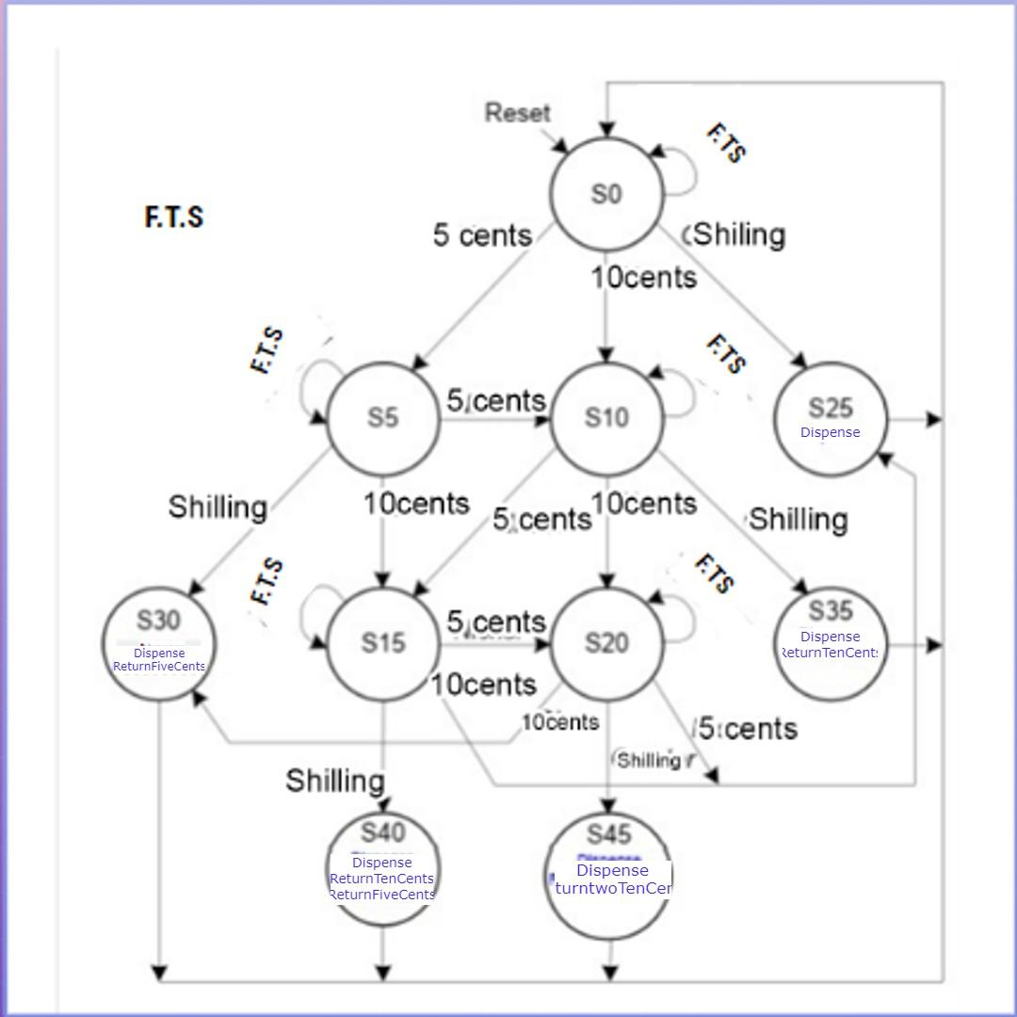
Finite State Machine

Slide 6
State Table
STATE | ENCODING S9:0
S0 | 0000000001
S5 | 0000000010
S10 | 0000000100
S25 | 0000001000
S30 | 0000010000
S15 | 0000100000
S20 | 0001000000
S35 | 0010000000
S40 | 0100000000
S45 | 1000000000

Slide 7
State Transition table
CURRENT STATE s | Input |  |  | NEXT STATE s'
 | F | T | S
S0 | 0 | 0 | 0 | S0
S0 | 0 | 0 | 1 | S25
S0 | 0 | 1 | 0 | S10
S0 | 1 | 0 | 0 | S5
S5 | 0 | 0 | 0 | S5
S5 | 0 | 0 | 1 | S30
S5 | 0 | 1 | 0 | S15
S5 | 1 | 0 | 0 | S10
S10 | 0 | 0 | 0 | S10

Slide 8
State transition table
CURRENT STATE s | Input |  |  | NEXT STATE s'
 | F | T | S
S10 | 0 | 0 | 1 | S35
S10 | 0 | 1 | 0 | S20
S10 | 1 | 0 | 0 | S15
S25 | X | X | X | S0
S30 | X | X | X | S0
S15 | 0 | 0 | 0 | S15
S15 | 0 | 0 | 1 | S40
S15 | 0 | 1 | 0 | S25
S15 | 1 | 0 | 0 | S20
S20 | 0 | 0 | 0 | S20
S20 | 0 | 0 | 1 | S45
S20 | 0 | 1 | 0 | S30
S20 | 1 | 0 | 0 | S25
S35 | X | X | X | S0
S40 | X | X | X | S0
S45 | X | X | X | S0

Slide 9
State transition table
CURRENT STATE s | Input |  |  | NEXT STATE s'
 | F | T | S
0000000001 | 0 | 0 | 0 | 0000000001
0000000001 | 0 | 0 | 1 | 0000001000
0000000001 | 0 | 1 | 0 | 0000000100
0000000001 | 1 | 0 | 0 | 0000000010
0000000010 | 0 | 0 | 0 | 0000000010
0000000010 | 0 | 0 | 1 | 0000010000
0000000010 | 0 | 1 | 0 | 0000100000
0000000010 | 1 | 0 | 0 | 0000000100
0000000100 | 0 | 0 | 0 | 0000000100
0000000100 | 0 | 0 | 1 | 0010000000
0000000100 | 0 | 1 | 0 | 0000000100
0000000100 | 1 | 0 | 0 | 0010000000
0000000100 | X | X | X | 0000000001
0000010000 | X | X | X | 0000000001
0000010000 | 0 | 0 | 0 | 0000100000
0000010000 | 0 | 0 | 1 | 0100000000
0000010000 | 0 | 1 | 0 | 0000001000
0000010000 | 1 | 0 | 0 | 0001000000
0001000000 | 0 | 0 | 0 | 0001000000
0001000000 | 0 | 0 | 1 | 1000000000
0001000000 | 0 | 1 | 0 | 0000010000
0001000000 | 1 | 0 | 0 | 0000001000
0001000000 | X | X | X | 0000000001
0100000000 | X | X | X | 0000000001
1000000000 | X | X | X | 0000000001

Slide 10
CURRENT STATE s | Input |  |  | NEXT STATE s'
 | F | T | S
0000000001 | 0 | 0 | 0 | 0000000001
0000000001 | 0 | 0 | 1 | 0000001000
0000000001 | 0 | 1 | 0 | 0000000100
0000000001 | 1 | 0 | 0 | 0000000010
0000000010 | 0 | 0 | 0 | 0000000010
0000000010 | 0 | 0 | 1 | 0000010000
0000000010 | 0 | 1 | 0 | 0000100000
0000000010 | 1 | 0 | 0 | 0000000100
0000000100 | 0 | 0 | 0 | 0000000100
0000000100 | 0 | 0 | 1 | 0010000000
0000000100 | 0 | 1 | 0 | 0000000100
0000000100 | 1 | 0 | 0 | 0010000000
0000001000 | X | X | X | 00000000001
0000010000 | X | X | X | 00000000001
0000100000 | 0 | 0 | 0 | 0000100000
0000100000 | 0 | 0 | 1 | 0100000000
0000100000 | 0 | 1 | 0 | 0000001000
0000100000 | 1 | 0 | 0 | 0001000000
0001000000 | 0 | 0 | 0 | 0001000000
0001000000 | 0 | 0 | 1 | 1000000000
0001000000 | 0 | 1 | 0 | 0000010000
0001000000 | 1 | 0 | 0 | 0000001000
0010000000 | X | X | X | 0000000001
0100000000 | X | X | X | 0000000001
1000000000 | X | X | X | 0000000001

Slide 11
OUTPUT TABLE
STATE | DISPENSE | RETURNFIVECENTS | RETURNTENCENTS | RETURNTWOTENCENTS
S5 | X | X | X | X
S10 | X | X | X | X
S15 | X | X | X | X
S20 | X | X | X | X
S25 | 1 | X | X | X
S30 | 1 | 1 | X | X
S25 | 1 | X | 1 | X
S40 | 1 | 1 | 1 | X
S45 | 1 | X | X | 1

Slide 12
OUTPUT TABLE
STATE ENCODING | DISPENSE | RETURNFIVECENTS | RETURNTENCENTS | RETURNTWOTENCENTS
0000001000 | 1 | X | X | X
0000010000 | 1 | 1 | X | X
0010000000 | 1 | X | 1 | X
0100000000 | 1 | 1 | 1 | X
1000000000 | 1 | X | X | 1

Slide 13
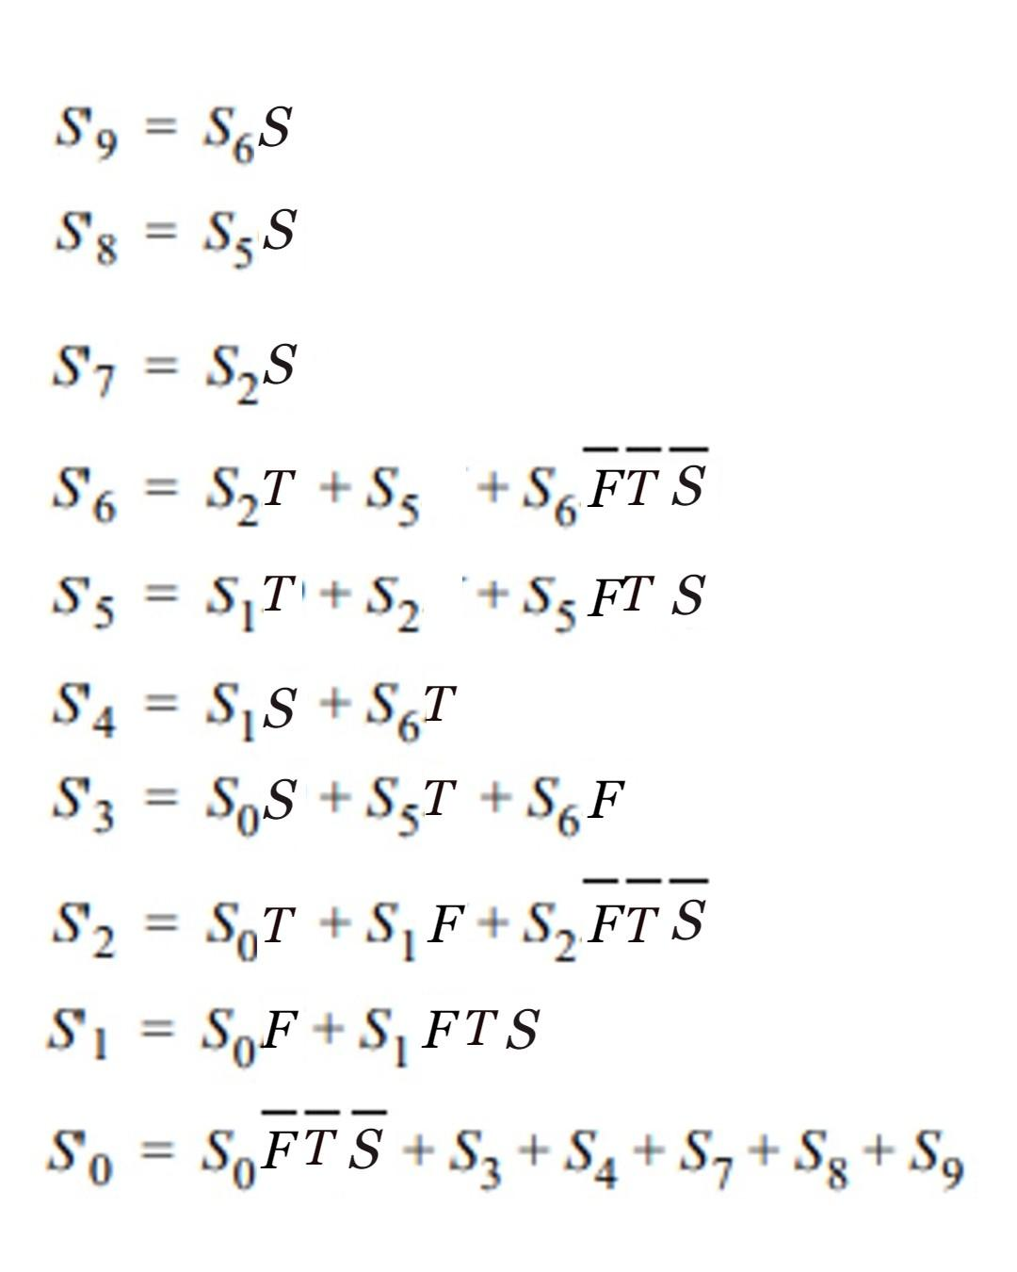
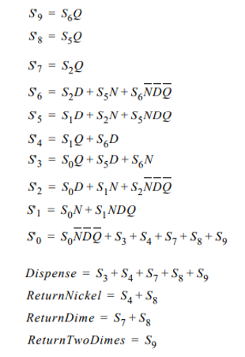
OUTPUT TABLE EQUATIONS
DISPENSE
RETURNFIVECENTS
RETURNTENCENTS
RETURNTWOTENCENTS

Slide 14
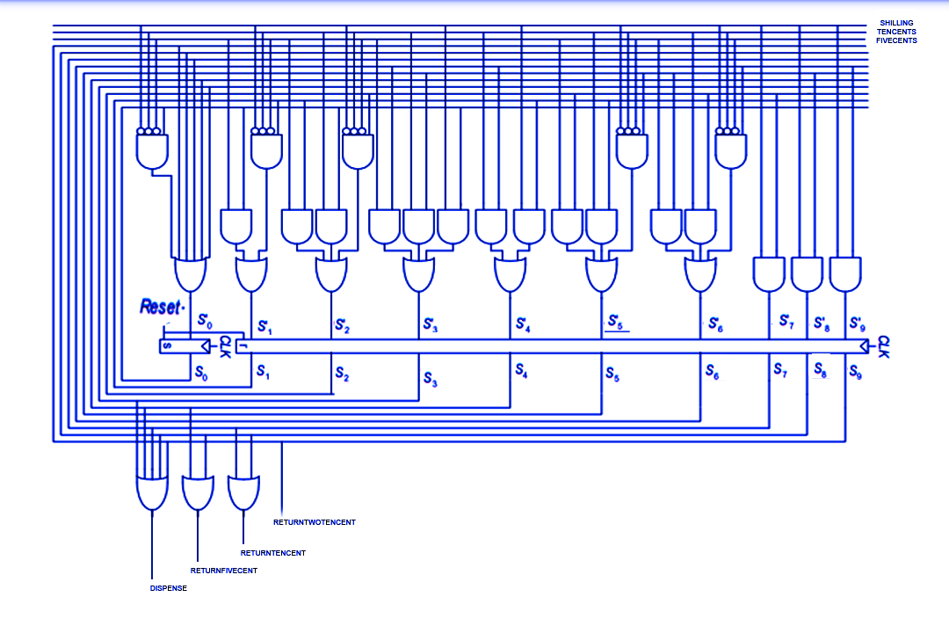
CIRCUIT DIAGRAM

Slide 15
Thank you for your attention!

